Slide 1
Welcome 2023
Future Tax Leaders
  Virtual wrap-up
  November 29, 2023

Slide 2
Disclaimer
Views expressed in this presentation are those of the speakers and do not necessarily represent the views of Ernst & Young LLP or other members of the global EY organization.
This presentation is provided solely for the purpose of enhancing knowledge on tax matters. It does not provide tax or accounting advice to any taxpayer because it does not take into account any specific taxpayer’s facts and circumstances. Please refer to your advisors for specific advice.
Ernst & Young LLP expressly disclaims any liability in connection with use of this presentation or its contents by any third party.
EY refers to the global organization, and may refer to one or more, of the member firms of Ernst & Young Global Limited, each of which is a separate legal entity. Ernst & Young LLP is a client-serving member firm of Ernst & Young Global Limited operating in the US.
This presentation is © 2023 Ernst & Young LLP. All Rights Reserved. No part of this document may be reproduced, transmitted or otherwise distributed in any form or by any means, electronic or mechanical, including by photocopying, facsimile transmission, recording, rekeying, or using any information storage and retrieval system, without written permission from Ernst & Young LLP. Any reproduction, transmission or distribution of this form or any of the material herein is prohibited and is in violation of US and international law.

Slide 3
FTL Program* leaders
Bob Vuillemot
  Ernst & Young LLP
  Pittsburgh, PA
  robert.vuillemot@ey.com
  +1 412 644 5313
Kristen Farr Capizzi
  Ernst & Young LLP
  Chicago, IL
  kristen.g.farr.capizzi@ey.com
  +1 847 287 3146
Kathy Pitts
  Ernst & Young LLP
  Birmingham, AL
  kathy.pitts@ey.com
  +1 205 254 1608
* Ernst & Young LLP Exempt Organizations Future Leaders Tax (FTL) Program

Slide 4
Today’s agenda and program overview
Time (ET) | Session | Speakers
1:00 p.m.–1:10 p.m. | Opening remarks | Bob Vuillemot
1:10 p.m.–2:15 p.m. | FTL Tax Director Panel | Bob Vuillemot John Sanchez, Tufts University Adam Bourns, Memorial Hermann Health System Hannah Rose, Mercy Health System
2:15 p.m.–2:30 p.m. | Website and resources demo | Kristen Farr Capizzi
2:30 p.m.–2:40 p.m. | Break
2:40 p.m.–3:25 p.m. | Round table break out rooms | Bob Vuillemot, Kathy Pitts and Steve Clarke
3:25 p.m.–3:30 p.m. | Closing remarks | Bob Vuillemot

Slide 5
Polling question 1
How long have you been employed by your current organization?
Less than one year
One to five years
Six to 15 years
Over 15 years
Not applicable (EY, faculty, alumni, other)

Slide 6
Learning objectives
Review and discuss tax leader opportunities in your organization.
Recognize the various tools and resources available for tax technical matters and relevant tax technical updates.
Identify areas in your organization which could benefit from specific tax planning scenarios.

Slide 7

FTL Tax Director Panel

Slide 8
Polling question 2
What would you most like to learn from other leaders in your field?
How they got to where they are
What areas do they find most challenging in their current roles
How they stay current on tax matters
Other (answer poll and provide example in chat)

Slide 9
FTL Tax Director Panel
Introductions
What was your path to becoming a tax director?
What is it like to be a tax director?
What was your path to becoming a tax leader in your organization?

Slide 10
Polling question 3
True or false: I have regular contact with the tax director in my organization.
True
False

Slide 11
Polling question 4
True or false: I plan to continue to network with other Future Tax Leaders I’ve met during this program.
True
False

Slide 12

Website and resources demo
2023 Future Tax Leaders Program

Slide 13
Resources demo
EY resources
FTL website (eofutureleaders.ey.com)
Tax Alerts (https://taxnews.ey.com/Register/Register.aspx)
EY Thought Center webcasts (Webcasts | EY – US)

Slide 14
Polling question 5
True or false: I have used an EY resource in the past or plan to use one in the future.
True
False

Slide 15
Resources demo
IRS resources
Exempt Organizations (EO) Update (Current Edition of Exempt Organizations Update | Internal Revenue Service (irs.gov)
Tax-Exempt and Government Entities Newsletter (Tax-Exempt and Government Entities Newsletter | Internal Revenue Service (irs.gov))
Tax Exempt Organization Search Bulk Data Downloads (www.irs.gov/charities-non-profits/tax-exempt-organization-search-bulk-data-downloads)
Exempt Organizations Business Master File Extract (EO BMF) (www.irs.gov/charities-non-profits/exempt-organizations-business-master-file-extract-eo-bmf)

Slide 16
Polling question 6
True or false: I have used an IRS resource in the past or plan to use one in the future.
True
False

Slide 17

Break

Slide 18
Polling question 7
How many of the six virtual technical education sessions did you attend?
1
2
3
4
5
6

Slide 19

Round table breakout rooms

Slide 20
Polling question 8
What is the most pressing matter likely to impact your organization?
New legislation
IRS and/or state and local examinations
Remote workforce
Other (answer poll and provide example in chat)
Not applicable (EY, faculty, alumni, other)

Slide 21
Breakout rooms
Introductions
Staffing levels and obtaining the resources the tax department needs
How to demonstrate the tax department value to the larger organization
  Risk mitigation
  Expenses reduction
  Revenue generated
Procedural/technical discussion
  IRS examination issues/challenges
  What areas have you seen the IRS focus on?
  What challenges are you facing with the Form 990-T reporting?
    Expense allocations
    Charitable deductions
    Alternative expense deductions

Slide 22
Breakout rooms, cont.
The recent 2022 filing season
  What went well?
  What could have gone better?
  How do you communicate this to the larger team?
Questions?

Slide 23
Polling question 9
True or false: The FTL webcasts were valuable to my learning.
True
False

Slide 24
Polling question 10
True or false: I felt like my FTL buddy was available for questions.
True
False

Slide 25
Polling question 11
Would you recommend the FTL Program to others in your organization or field?
Yes
No

Slide 26
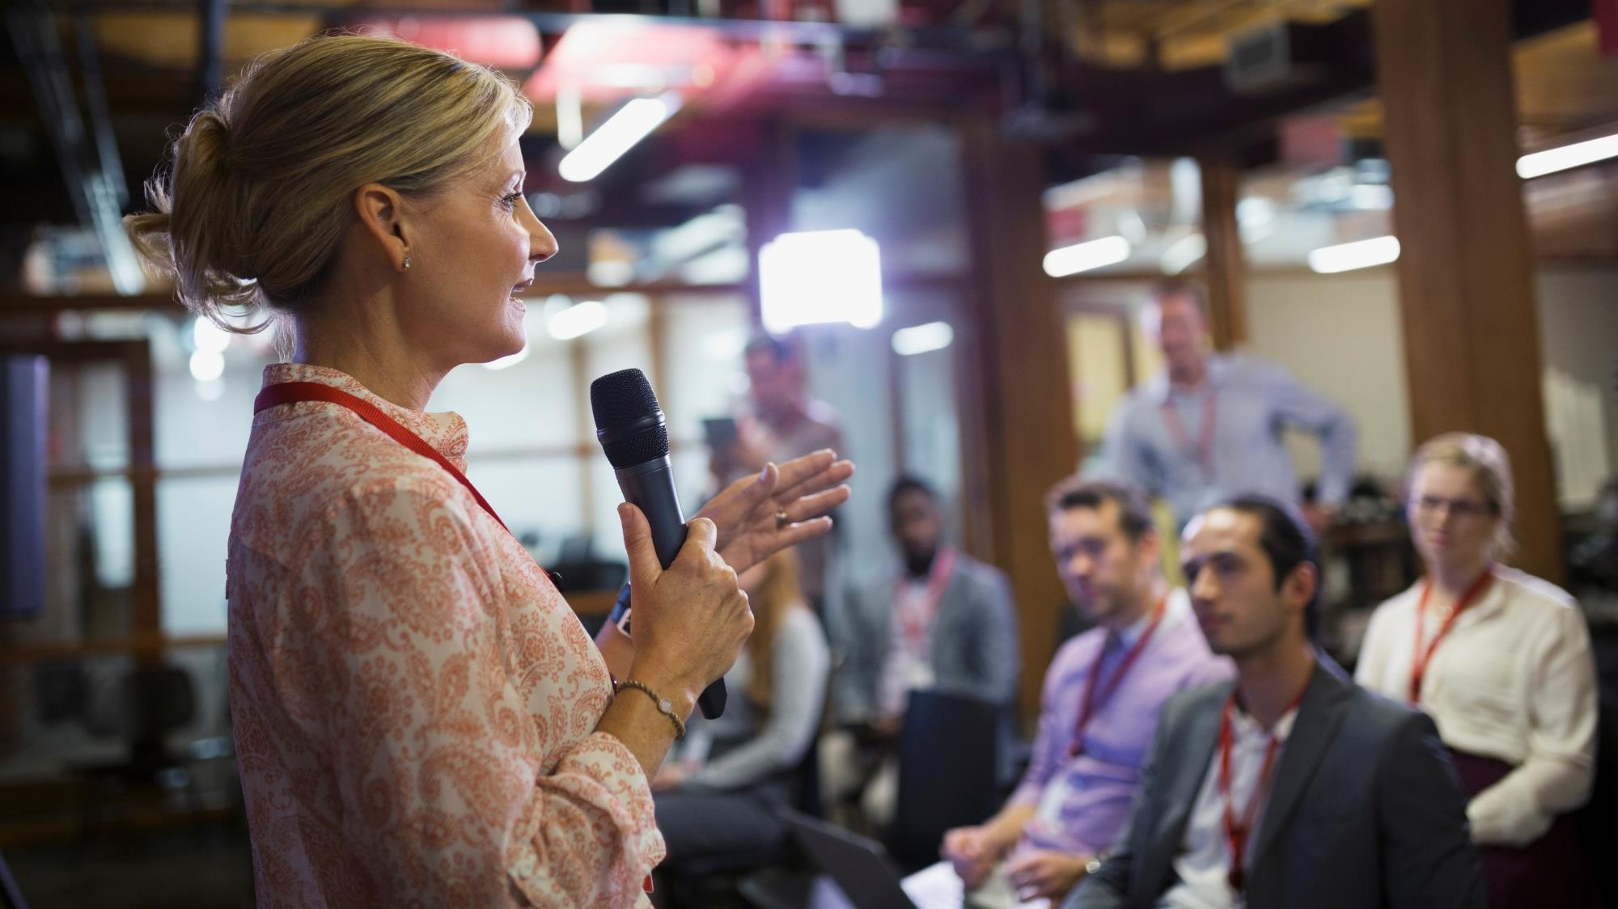
Closing remarks

Slide 27
EY | Building a better working world
EY exists to build a better working world, helping to create long-term value for clients, people and society and build trust in the capital markets.
Enabled by data and technology, diverse EY teams in over 150 countries provide trust through assurance and help clients grow, transform and operate.
Working across assurance, consulting, law, strategy, tax and transactions, EY teams ask better questions to find new answers for the complex issues facing our world today.
EY refers to the global organization, and may refer to one or more, of the member firms of Ernst & Young Global Limited, each of which is a separate legal entity. Ernst & Young Global Limited, a UK company limited by guarantee, does not provide services to clients. Information about how EY collects and uses personal data and a description of the rights individuals have under data protection legislation are available via ey.com/privacy. EY member firms do not practice law where prohibited by local laws. For more information about our organization, please visit ey.com.
Ernst & Young LLP is a client-serving member firm of Ernst & Young Global Limited operating in the US.
© 2023 Ernst & Young LLP.
All Rights Reserved.
US SCORE no. 21703-231US
2311-4381534
ED: None
ey.com

