Slide 1
2025 Future Tax Leaders — international tax issues
August 28, 2025

Slide 2
Disclaimer
EY refers to the global organization, and may refer to one or more, of the member firms of Ernst & Young Global Limited, each of which is a separate legal entity. Ernst & Young LLP is a client-serving member firm of Ernst & Young Global Limited operating in the US.
This presentation is © 2025 Ernst & Young LLP. All Rights Reserved. No part of this document may be reproduced, transmitted or otherwise distributed in any form or by any means, electronic or mechanical, including by photocopying, facsimile transmission, recording, rekeying, or using any information storage and retrieval system, without written permission from Ernst & Young LLP. Any reproduction, transmission or distribution of this form or any of the material herein is prohibited and is in violation of US and international law. Ernst & Young LLP expressly disclaims any liability in connection with use of this presentation or its contents by any third party.
The views expressed by the presenters are not necessarily those of Ernst & Young LLP or other members of the global EY organization.
This presentation is provided solely for the purpose of enhancing knowledge of tax matters. It does not provide accounting, tax, legal or other professional advice because it does not take into account any specific taxpayer’s facts and circumstances.
Neither EY nor any member firm thereof shall bear any responsibility whatsoever for the content, accuracy or security of any third-party websites that are linked (by way of hyperlink or otherwise) in this presentation.

Slide 3



Presenters
Neelu Mehrotra
Managing Director
International Tax and Transaction Services
Ernst & Young LLP
Janine Brzezinski
Managing Director
International Tax and Transaction Services Ernst & Young LLP
Jess Wagener
Senior Manager
Exempt Organization Tax Services Ernst & Young LLP
Page

Slide 4
CPE eligibility
We will launch at least three polls per CPE credit. Participants must attend the full session and respond at least three polls per CPE credit to receive full credit.
Page 4

Slide 5

Agenda
Intro and objectives
International tax controversy developments
Key insights and issues for TY2024 compliance
Overview of commonly filed international forms including Forms 926, 8865 and 5713
Questions and closing remarks

Slide 6

Objectives
Outline key international tax controversy developments
Discuss key insights and issues related to international compliance
Review TY2024 international form and instruction updates
Identify reporting requirements for Forms 926, 8865 and 5713
Page 6

Slide 7
01
International tax controversy developments

Slide 8
US audit focus and what to watch for in 2025
Audit focus
Environment remains dynamic
More common use of the economic substance doctrine (ESD)
Particularly in transactions involving losses
Heightened expectations for substantiation
Interest expenses and section 163(j) limitations
Penalties asserted for substantial understatements as a matter of course, requiring the taxpayer to provide a reasonable cause statement

Slide 9
Tax controversies to watch in 2025
Issue | Notable activity
Economic substance | Application of ESD to disallow section 245A deduction
Validity of the blocked income regulations in Treas. Reg. §1.482-1(h)(2) | Taxpayer’s pending appeal to the Eighth Circuit
Use of group support in interest rate analyses | In Advice Memorandum (AM 2023-008), the IRS Chief Counsel concluded that the “implicit support” from group membership may be considered when determining the arm’s-length interest rate charged for intragroup loans Litigation of this issue is pending

Slide 10
Tax controversies to watch in 2025
Issue | Notable activity
Validity of section 965 transition tax | Constitutional challenge to the section 965 transition tax
Form 5471 penalties | Tax Court held that the IRS cannot assess penalties under section 6038 for the failure to file Form 5471
Self-employment taxes for LPs | Following an IRS-favorable decision on summary judgment, a trial on the facts regarding the “functions” of limited partners (LPs) is pending
Intangible property license; inclusion of stock-based compensation in cost base | Pending decision from the Tax Court

Slide 11
Polling No. 1
What controversy issue do you think will have the biggest impact on audits in 2025?
A. Economic substance
B. Validity of the blocked income regulations in Treasury Regulation section 1.482-1(h)(2)
C. Section 965 transition tax
D. Form 5471 penalties
E. Intangible property license; inclusion of stock-based compensation in cost base
F. N/A – EY, faculty, other
Page 11
Notes:
No Correct answer

Slide 12
IRS budgets: FY2023-2025
Funding bucket | FY2023 enacted | FY2024 enacted | FY2025 President’s request | FY2025 House Appropriations FSGG* Subcommittee
Taxpayer service | $2.7b | $2.8b | $2.8b | $2.8b
Enforcement | $5.4b | $5.4b | $5.4b | $3.4b
Operations support | $4.1b | $4.1b | $4.1b | $3.75b
Business systems modernization | $0 | $0 | $0 | $150m
Total | $12.2b | $12.3b | $12.3b | $10.1b
* FSGG = Financial Services and General Governance

Slide 13
IRS’s 2024 IRA* strategic operating plan: Annual update supplement Trends in audit activity
Number of new exam starts
Type of taxpayer | FY2018 | FY2019 | FY2020 | FY2021 | FY2022 | FY2023 | FY2024 target | FY2025 target
High income individuals** | 2,307 | 2,108 | 2,693 | 2,227 | 3,625 | 4,326 | 4,398 | 3,848
Partnerships | 9,033 | 5,823 | 4,106 | 4,327 | 3,155 | 6,709 | 4,074 | 5,215
Large corps.*** | 2,396 | 2,009 | 1,700 | 1,490 | 1,365 | 1,400 | 1,250 | 1,375
* IRA = individual retirement arrangement
** Individual return filers reporting over $10 million of total positive income
*** Returns reporting assets of $250 million and above
Source: https://www.irs.gov/pub/irs-pdf/p3744a.pdf, page 41.

Slide 14
Polling No. 2
True or false: The organization I work for has undergone an IRS audit in the last three years.
A. True
B. False
C. N/A – EY, faculty, other
Page 14
Notes:
No Correct answer

Slide 15
02
Key insights and issues for TY2024 compliance

Slide 16
Summary of changes to international forms
IRS form | Material changes
Form 5471 | Added line item 20 (a and b) to Schedule G regarding the application of top-up taxes New Schedule H-1 added to Form 5471 similar to the 2023 Worksheet H-1 Schedule Q, column (xv), line 4 no longer greyed out
Form 8858 | Principal business activity code number now required (previously only a description was required) New Schedule G, question 14 regarding top-up taxes paid or accrued Clarifications to the instructions for category of filers
Form 8865 | Updated the codes used for Schedule K-1 instructions for items: 15. Credits: codes S, W, X and AN and 20. Other information: codes AD, AV and AX
Form 8865 Schedule K-2 | New column (j) - Election by partnership added in section 1 of Part VII Part VIII, section 2, line 7 description was updated from “Reserved for future use” to “Cost sharing transactions payments” Part VIII, section 2, line 17–18 description was updated to include more detail regarding the 30% statutory rate
Form 8865 Schedule K-3 | No changes to form or instructions

Slide 17
Summary of changes to international forms
IRS form | Material changes
Form 1118 (FTC) | No changes to form or instructions
Form 926 | No changes to form or instructions
Form 8990 (§163(j)) | Updated instructions to indicate that the gross receipts test threshold for tax years beginning in 2024 is $30m No change to Form 8990 for 2024 tax years
Form 8991 (base erosion and anti-abuse tax (BEAT)) | Additional detail in Schedule A, including new line for cost-sharing transaction payments as defined in Reg. § 1.482-7(b)(1)(I)
Form 8992 (global intangible low-taxed income (GILTI)) | Clarifying information added to the instructions for Schedule B
Form 8993 (foreign-derived intangible income (FDII)) | Specific instructions for line 29, GILTI deduction, revised for purposes of clarification

Slide 18
Polling No. 3
Have you filed a Form 5471 before?
A. Yes
B. No
D. N/A – EY, faculty, other
Page 18
Notes:
No Correct answer

Slide 19
What is Form 5471?
In essence, federal Form 5471 is used to report the specifics of a domestic filer’s investments in a foreign corporation when their ownership interest is 10% or more or when it drops below 10% during the filer’s tax year.
The instructions clarify that “all U.S. persons identified in the Categories of Filers ... are required to complete the schedules, statements, and/or other information requested in the chart, Filing Requirements for Categories of filers.” (You can find the Form 5471 instructions at Instructions for Form 5471).
Page 19

Slide 20
Polling No. 4
How much time do you spend aggregating and populating the Form 5471 Schedule Q?
A. Less than 5 hours per Form 5471
B. 5–10 hours per Form 5471
C. More than 20 hours per Form 5471
D. N/A – EY, faculty, other
Page 20
Notes:
No Correct answer

Slide 21
Schedule O — How to present transactions
 | Part I | Part II
 | To be completed by US officers and directors* | Section A – General shareholder information* | Section B – US persons who are officers or directors of the foreign corporation* | Section C – Acquisition of stock* | Section D – Disposition of stock* | Section E – Organization or reorganization of foreign corporation*
Incorporation of CFC |  | X |  |  |  | X
Acquisition of CFC (Depiction 1) |  | X |  | X
Disposition of US shareholder interest — only report if interest drops below 10% (Depiction 2) |  | X |  |  | X
US shareholder increase in 10% ownership |  | X |  | X
351 contribution – not required unless part of entity organization
CFC only changes its name change |  | X |  |  |  | X
Check the box election ** |  | X |  |  | X | X
Reorganization — 368(a) (Depiction 3) |  | X |  |  |  | X
Section 332 — Liquidation — actual |  | X |  |  | X
Captive Insurance Companies — Section 953(c) | X |  | X | X | X
Schedule O should only be required is US shareholder’s interest (by vote or value) in CFC increases by 10% or more
Schedule O should generally not be required in respect of a contribution to CFC that is not part of the organization or formation of CFC
*See form instructions for applicability of specific sections of Schedule O, especially in terms of what should be reported in Part I and Part II, Section B
**Presentation depends on whether corporation is checking to be a disregarded entity or disregarded entity is un-checking the box to be regarded

Slide 22
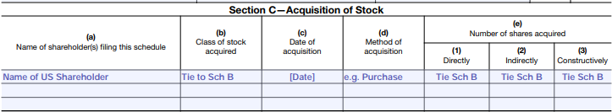
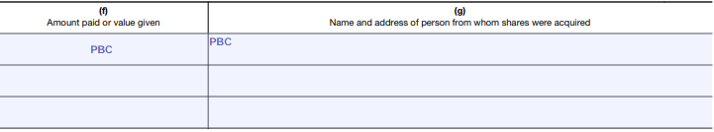
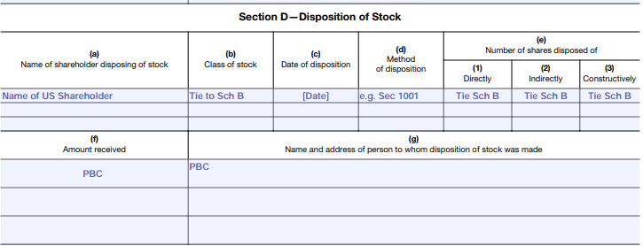
Schedule O — Depictions of transactions
Depiction 1: Acquisition of stock or increase in ownership greater than 10%
Depiction 2: Disposition of stock

Slide 23
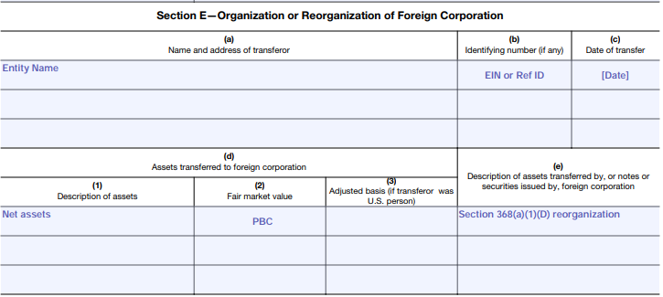
Schedule O — Depictions of transactions
Depiction 3: Reorganization

Slide 24
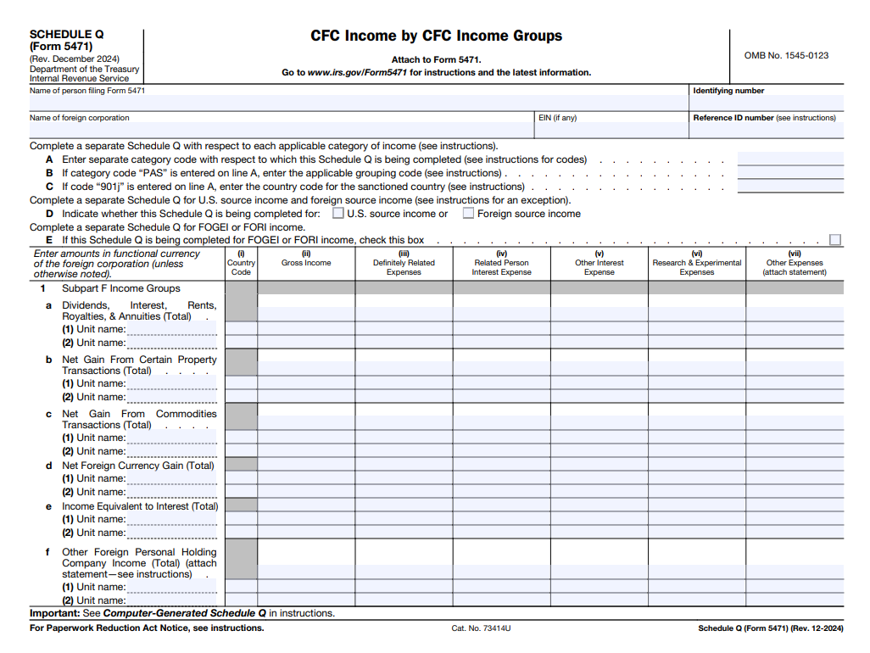
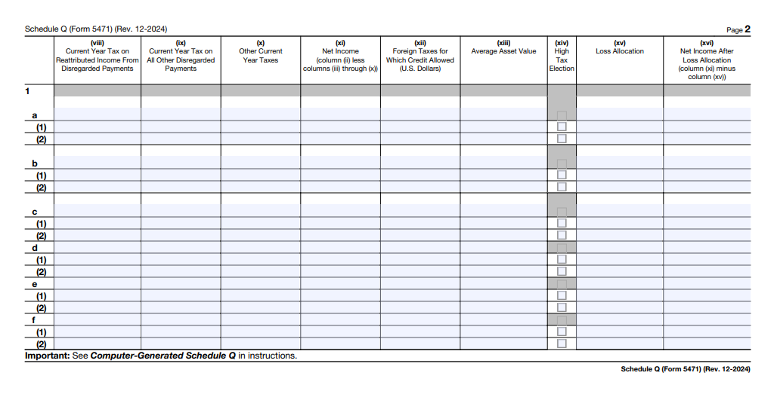
Form 5471, Schedule Q, Pages 1–2
Basket-level reporting
Aligns with Form 1118, Schedule A
Aligns with Form 5471, Schedule E
Aligns with Form 1118, Schedule B
Entity-level reporting
Aligns with Form 8858
Subpart F by type
Aligns with Form 5471, Schedule I
Aligns with Form 1118, Schedule A

Slide 25
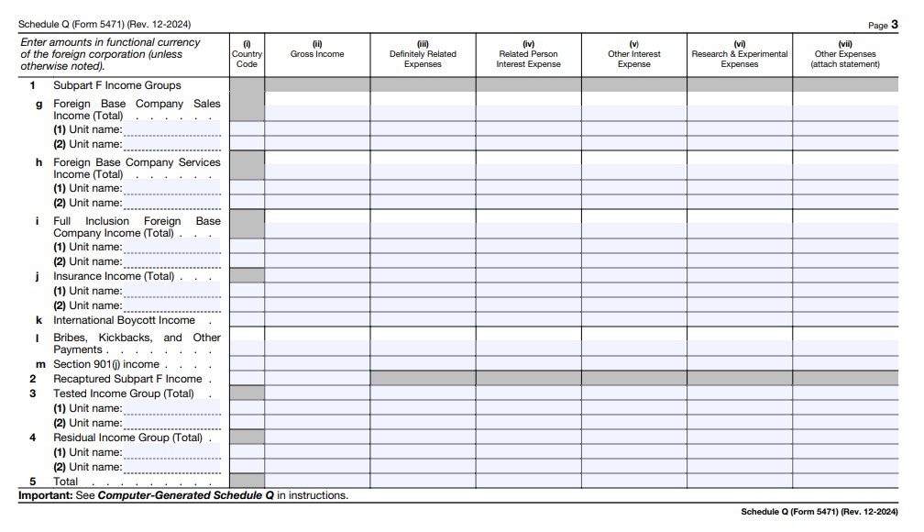
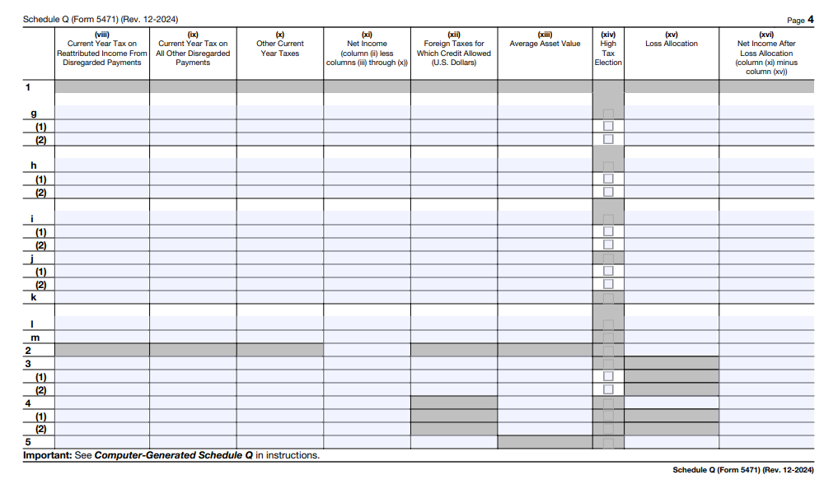
Form 5471, Schedule Q, Page 3–4
Gross Subpart F income – reconcile to Form 5471, Schedule I-1 excluded income
Tested income – reported on Form 8992 and Form 1118

Slide 26
What to focus on when completing international forms
Evolution of international forms: International tax forms have evolved to create a detailed audit trail of key international tax system (ITS) attributes
Entity-level vs. consolidated reporting:
Distinction between entity-level reporting and consolidated reporting for controlled foreign corporations (CFCs)
Impacts how income and expenses are reported
Importance of accurate reporting:
Critical to report information accurately and consistently to avoid penalties and achieve compliance
Misreporting can lead to significant tax implications

Slide 27
What to focus on when completing international forms (continued)
Interrelated schedules:
Many forms and schedules are interrelated, necessitating careful coordination
Relationships to other forms can affect overall tax liability and compliance
Form 5471, Schedule Q:
Schedule serves as a key example of how detailed reporting is structured
Provides a roadmap for understanding the flow of information and compliance requirements
Foreign inclusions:
Includes Subpart F income and GILTI
Essential for understanding income inclusions from CFCs
Foreign tax credits:
FTCs are important for mitigating double taxation on foreign income
Interaction with Form 5471 and Schedule Q is crucial for accurate reporting

Slide 28
03
Overview of commonly filed international forms including Forms 926, 8865 and 5713

Slide 29
Polling No. 5
Do you outsource, co-source or handle your international compliance internally?
A. Outsource
B. Co-source
C. In house
D. N/A – EY, faculty, other
Page 29
Notes:
No Correct answer

Slide 30
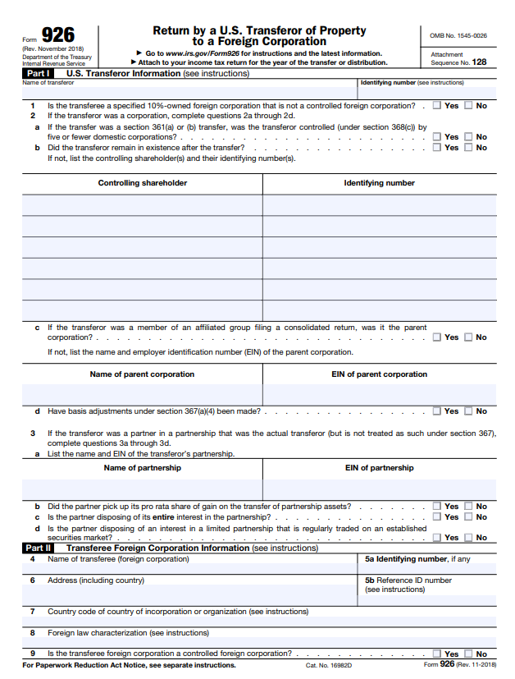
Form 926 — transfers to foreign corporations
Form 926 is required for:
Direct or indirect transfers of more than $100,000 to a foreign corporation during the 12-month period ending on the date of the transfer
Transfers where, immediately after the transfer, the taxpayer holds, directly or indirectly, 10% ownership
Transfers of intangible property (e.g., patents, know-how, services, goodwill) are reportable regardless of value
Includes scenarios where no cash is exchanged but equity or other consideration is received in return
Page 30

Slide 31
12-month rolling transfer analysis
The IRS requires a taxpayer to file Form 926 if they transfer more than $100,000 in cash to a foreign corporation during any 12-month period.
This is not limited to a calendar year. Instead, it is a rolling window — meaning:
You must look back 12 months from the date of each transfer
If the cumulative total of cash transferred during that period exceeds $100,000, you must file Form 926
Example — Suppose you transferred:
$40,000 on March 1, 2025
$30,000 on August 1, 2025
$50,000 on February 1, 2026
On February 1, 2026, the total transferred in the prior 12 months (from February 1, 2025 to February 1, 2026) is:
$40,000 (March 1, 2025) + $30,000 (August 1, 2025) + $50,000 (February 1, 2026) = $120,000
Even though neither tax year exceeds the $100,000 threshold, the cumulative amount in a 12-month period is greater than $100,000. Therefore, a filing will be required for 2026 showing the $50,000 transfer.

Slide 32
Polling No. 6
True or false: A 12-month rolling analysis is not necessary for Form 926 filing purposes.
A. True
B. False
Page 32
Notes:
False

Slide 33
Form 8865 — transfers to foreign partnerships
Types of filer:
Category 1: US person who controlled (more than 50% interest) the foreign partnership at any time during the partnership’s tax year
Category 2: US person who owned at least 10% at any time during the tax year while the partnership was considered a controlled foreign partnership (controlled by US persons owning at least 10% interest)
If the foreign partnership had a Category 1 filer at any time during the tax year, no person will be considered a Category 2 filer
Category 3: Contribution of property that either:
Was owned directly or constructively with at least a 10% interest in the foreign partnership immediately after the contribution
Or the value of the property contributed (when added to the value of any other property contributed to the partnership by such person or any related person during the 12-month period ending on the date of transfer) exceeds $100,000
Category 4: Reportable event (acquisitions, dispositions or changes in proportional interest)
Page 33

Slide 34
Example: Controlling 10% partner
Foreign partner
45%
US partner A
45%
US partner B
10%
In this example, a foreign partnership is considered a controlled foreign partnership (CFP) because it is controlled by US persons owning 10% or greater interests.
Because US partner A and US partner B are 10% controlling partners, each will have a Category 2 Form 8865 filing requirement.
Other categories may also be applicable, depending on the facts and circumstances.
Foreign
partnership
Page 34

Slide 35
Example: Indirect filing requirements
Facts:
US partner owns 55% of foreign partnership
Foreign partnership owns 50% of foreign corporation at the end of the year
Foreign partnership contributed $300,000 to foreign corporation during the tax year
Before the contribution, foreign partnership owned 30% of foreign corporation
Foreign corporation is a CFC
US partner 55%
Filing requirements:
US partner will have a Category 1 Form 8865 filing requirement for its ownership in the foreign partnership
US partner will have a Category 3 and 5a Form 5471 filing requirement for the foreign corporation
US partner will have a Form 926 filing requirement for the contribution made by the foreign partnership to the foreign corporation
Note: If the foreign partnership was instead a US partnership that had filed a Form 5471 and reported the necessary Category 3 and Category 5a information, the US partner would no longer have a filing requirement.
Foreign
partnership
50%
Foreign corporation

Slide 36
Example: Master-feeder model
Facts:
Foreign feeder is treated as a corporation for US tax purposes
Foreign master is treated as a partnership for US tax purposes
US shareholder owns 55% of the foreign feeder
Foreign feeder owns 20% of the foreign master
Foreign master is a CFP
There are no Form 8865 Category 1 filers for the foreign master
US shareholder
55%
Filing requirements:
US shareholder will have a Category 4 Form 5471 filing requirement for its ownership in the foreign feeder
US shareholder will have a Category 2 Form 8865 filing requirement for its indirect ownership in the foreign master
Foreign feeder
20%
Foreign
master
Page 36

Slide 37
12-month rolling transfer analysis
The IRS requires a taxpayer to file Form 8865 if they transfer more than $100,000 in cash to a foreign partnership during any 12-month period
This is not limited to a calendar year. Instead, it is a rolling window — meaning:
You must look back 12 months from the date of each transfer
If the cumulative total of cash transferred during that period exceeds $100,000, you must file Form 8865

Slide 38
Form 5713 — reporting international boycott participation
Any US person must file Form 5713 if they:
Have operations in or related to a boycotting country
Receives a request to participate in an international boycott
Agree to participate in such a boycott
Tax-exempt organizations that engage in foreign activities — such as making grants to foreign individuals or owning foreign entities — should assess whether Form 5713 is required
Controlled group members: A corporation that is part of a controlled group must file Form 5713 if any member of the group has boycott-related operations. The filing must include the names and EINs of all group members not included in a consolidated return.
Filing and penalties: Form 5713 must be filed with the corporation’s income tax return by the due date, including extensions. Electronic filers are not required to submit a duplicate. Willful failure to file may result in a $25,000 fine, imprisonment for up to one year or both.
Page 38

Slide 39
Form 5713 — reporting international boycott participation (continued)
Operations include:
Selling, purchasing, leasing or licensing
Banking or financing
Extracting, processing, manufacturing or transporting
Providing services related to any of the above
Current countries include:
Iraq
Kuwait
Lebanon
Libya
Qatar
Saudi Arabia
Syria
Yemen
Page 39

Slide 40
Polling No. 7
True or false: You must file a Form 5713 if you have a bank account in Qatar.
A. True
B. False
Page 40
Notes:
True

Slide 41
Key takeaways
Understand key international tax controversy developments
Recognize key insights and issues with respect to international compliance
Identify TY2024 international form and instruction updates
Recognize Forms 926, 8865 and 5713 reporting requirements

Slide 42
Thank you and questions

Slide 43
Boilerplate
EY | Building a better working world
EY is building a better working world by creating new value for clients, people, society and the planet, while building trust in capital markets.
Enabled by data, AI and advanced technology, EY teams help clients shape the future with confidence and develop answers for the most pressing issues of today and tomorrow.
EY teams work across a full spectrum of services in assurance, consulting, tax, strategy and transactions. Fueled by sector insights, a globally connected, multidisciplinary network and diverse ecosystem partners, EY teams can provide services in more than 150 countries and territories.
All in to shape the future with confidence.
EY refers to the global organization, and may refer to one or more, of the member firms of Ernst & Young Global Limited, each of which is a separate legal entity. Ernst & Young Global Limited, a UK company limited by guarantee, does not provide services to clients. Information about how EY collects and uses personal data and a description of the rights individuals have under data protection legislation are available via ey.com/privacy. EY member firms do not practice law where prohibited by local laws. For more information about our organization, please visit ey.com.
Ernst & Young LLP is a client-serving member firm of Ernst & Young Global Limited operating in the US.
© 2025 Ernst & Young LLP.
All Rights Reserved.
US SCORE no. 28053-251US
2410-11955-CS
ED None
This material has been prepared for general informational purposes only and is not intended to be relied upon as accounting, tax, legal or other professional advice. Please refer to your advisors for specific advice.
ey.com

